Slide 1
Topic Modeling

Slide 2
Topic Modeling
Unsupervised machine learning technique used to automatically discover hidden themes or topics in a collection of text documents.
groups words that frequently occur together and identifies the underlying topics without requiring labeled data.

Slide 3
Topic Modeling
Collect a set of documents (e.g., articles, tweets, reviews).
Preprocess the text:
  Convert to lowercase
  Remove stop words
  Tokenize
  Stem or lemmatize words
Apply a topic modeling algorithm.
Interpret the discovered topics based on the most representative words.

Slide 4
Example
"The team won the football match."
"The player scored two goals."
"Stock markets rose after economic growth."
"Investors bought more shares."
Topic | Top Words
Sports | football, team, player, goals, match
Finance | market, investors, shares, economy, growth

Slide 5
Topic Modelling
1. Latent Dirichlet Allocation (LDA)
  Most widely used.
  Assumes each document contains multiple topics.
  Each topic is a probability distribution over words.
2. Latent Semantic Analysis (LSA)
  Uses matrix decomposition (Singular Value Decomposition).
  Captures hidden relationships between words and documents.
3. Non-negative Matrix Factorization (NMF)
  Factorizes the document-term matrix into non-negative matrices.
  Often produces interpretable topics.
4. BERTopic
  Modern approach using transformer embeddings, clustering, and class-based TF-IDF.
  Produces more coherent topics, especially for short texts.

Slide 6
Latent Semantic Analysis (LSA)
LSA uses Singular Value Decomposition (SVD) to identify hidden semantic relationships.
The Document-Term Matrix is decomposed as: A=UΣV^{T}
Where:
A = Document-Term Matrix
U = Document-topic relationship
Σ = Importance of topics
V^{T} = Topic-word relationship
Example
Words such as: football, player, goal, match
may be grouped into the hidden concept: SPORTS
Limitation : based on linear algebraic representation and does not provide a probabilistic interpretation.

Slide 7
Latent Dirichlet Allocation (LDA)
LDA is one of the most popular topic modeling algorithms.
Assumption 1 : A document contains multiple topics.
For example:
Document 1:
Sports = 70%
Politics = 30%
Assumption 2: A topic contains multiple words with different probabilities.
Sports Topic:
football = 30%
player = 25%
match = 20%
team = 15%
goal = 10%
Words in Documents
↓
Random Topic Assignment
↓
Calculate: P(Topic | Document) + P(Word | Topic)
↓
Reassign Words
↓
Repeat Many Times
↓
Stable Topic Assignments
↓
Final Document-Topic Distribution

Slide 8
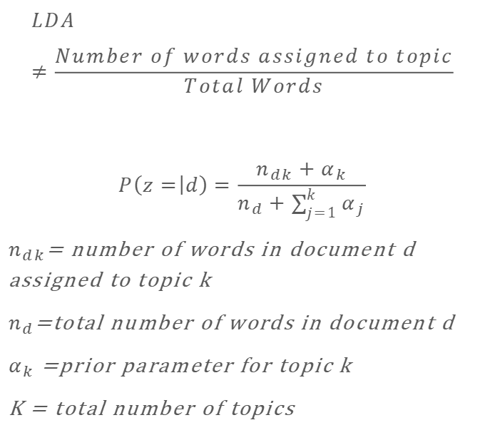
LDA Example
$$LDA≠\frac{Number of words assigned to topic}{Total Words}$$
$$P\left(z= | d\right)=\frac{n_{dk}+α_{k}}{n_{d}+\sum_{j=1}^{k}{α_{j}}}$$
$n_{dk}$= number of words in document d assigned to topic k
$n_{d}$=total number of words in document d
$α_{k}$ =prior parameter for topic k
K = total number of topics
Suppose:
Number of topics = 2
Document:
team won match government announced policy
Assume:
Topic Word Count
Sports 4
Politics 2
Total words:n_{d}=6
Let:α=1

Slide 9
Example
Sports : P(Sports∣D)= 5/8 = 0.625
Politics : P(Politics∣D)= 3/8 = 0.375
Thus, the document is approximately:
62.5% Sports and 37.5% Politics

Slide 10
Example
Document 1:
The football team won the match. The players scored goals.
Document 2:
The cricket team played a good match. The players performed well.
Document 3:
The stock market increased. Investors bought more shares.
Topic | Important Words
Topic 1: Sports | football, cricket, team, players, match, goals
Topic 2: Finance | stock, market, investors, shares
The topics are not explicitly provided. The algorithm discovers them automatically

Slide 11
A document may contain multiple topics.
For example:
The government invested in sports infrastructure and increased the sports budget.
This document may contain:
70% Sports
30% Government/Finance
Similarly, a topic is represented as a probability distribution over words:
Word | Probability
football | 0.25
player | 0.2
match | 0.18
team | 0.15
goal | 0.12
Document→Mixture of Topics Topic→Distribution of Words

Slide 12
Collection of Documents
↓
Text Preprocessing
↓
Tokenization
↓
Stopword Removal
↓
Lemmatization
↓
Document-Term Matrix
↓
Topic Modeling Algorithm
↓
Hidden Topics
↓
Topic Interpretation

Slide 13
Text Preprocessing
Example
Original sentence:
"The students are studying machine learning algorithms."
After preprocessing:
students studying machine learning algorithms
Common steps:
Tokenization
Lowercase conversion
Stop-word removal
Stemming or Lemmatization
Removal of punctuation and special symbols

Slide 14
Document Term Matrix
Document | Text
D1 | football team won match
D2 | cricket team played match
D3 | stock market investors
Document | football | team | match | cricket | stock | market | investors
D1 | 1 | 1 | 1 | 0 | 0 | 0 | 0
D2 | 0 | 1 | 1 | 1 | 0 | 0 | 0
D3 | 0 | 0 | 0 | 0 | 1 | 1 | 1

Slide 15
Non-Negative Matrix Factorization (NMF)
NMF factorizes the document-term matrix: V≈WH
Where:
V = Original document-term matrix
W = Document-topic matrix
H = Topic-word matrix

Slide 16
BERT
BERTopic is a modern topic modeling approach based on transformer embeddings.
For example:
"AI diagnoses diseases"
"Machine learning detects cancer"
"Deep learning helps doctors"
These sentences may be grouped into: Topic: AI in Healthcare
BERTopic is particularly useful for:
Short texts
Social media posts
Customer reviews
News articles
Process
Documents
↓
Transformer Embeddings
↓
Dimensionality Reduction
↓
Clustering
↓
c-TF-IDF
↓
Topics

Slide 17
Topic modelling comparison
Method | Main Technique | Advantages
LSA | SVD | Simple and fast
LDA | Probabilistic model | Interpretable topics
NMF | Matrix factorization | Good topic interpretability
BERTopic | Transformer embeddings + clustering | Handles semantic meaning better

